Slide 1
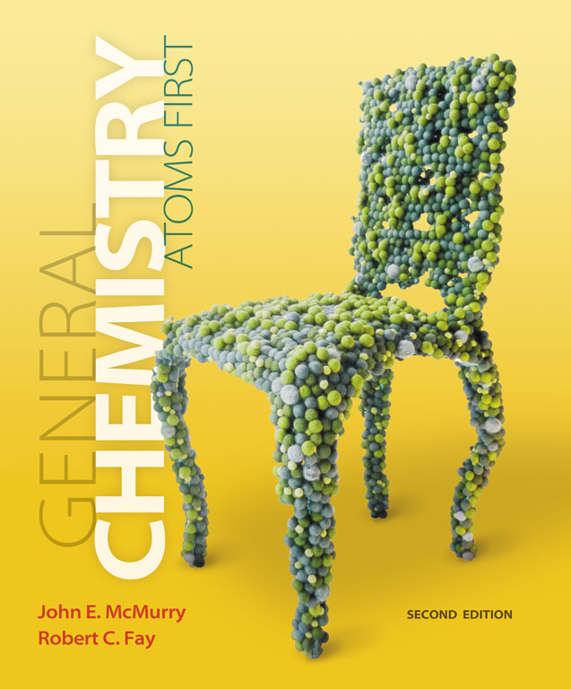
Clicker Questions
Chapter 8
Thermochemistry:
Chemical Energy
Donald Linn
Indiana University–
Purdue University Fort Wayne
Fort Wayne, IN

Slide 2
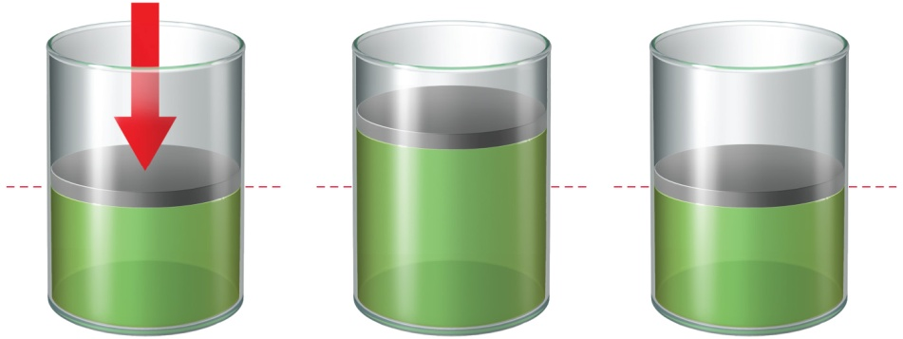
1.8 atm
1.8 atm
The work associated with the process depicted to the right is which of the following?
(Hint: 1 J = 0.009869 L atm)
4.0 L
6.0 L
a) 365 J
d) –730 kJ
b) –365 J
e) 1095 kJ
c) 730 J
Notes:
Answer: b

Slide 3
1.8 atm
1.8 atm
The work associated with the process depicted to the right is which of the following?
(Hint: 1 J = 0.009869 L atm)
4.0 L
6.0 L
a) 365 J
d) –730 kJ
b) –365 J
e) 1095 kJ
c) 730 J
Notes:
Answer: b

Slide 4
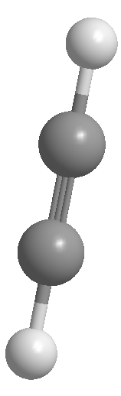
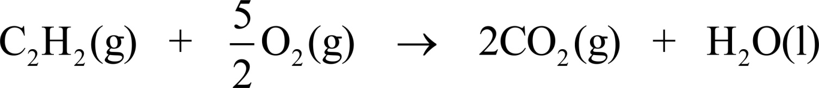
When 1 mol of acetylene (C₂H₂) is burned at room temperature and at constant pressure, 1254 kJ of heat is liberated from the system when the products return
to 298 K.
What is the internal energy change of this chemical system when 1 mol of acetylene is burned if PΔV is +4 kJ?
a) 1250 kJ
c) 1258 kJ
b) –1250 kJ
d) –1258 kJ
e) None of the above
Notes:
Answer: d

Slide 5
When 1 mol of acetylene (C₂H₂) is burned at room temperature and at constant pressure, 1254 kJ of heat is liberated from the system when the products return
to 298 K.
What is the internal energy change of this chemical system when 1 mol of acetylene is burned if PΔV is +4 kJ?
a) 1250 kJ
c) 1258 kJ
b) –1250 kJ
d) –1258 kJ
e) None of the above
Notes:
Answer: d

Slide 6
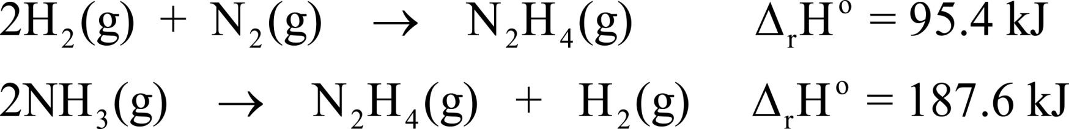
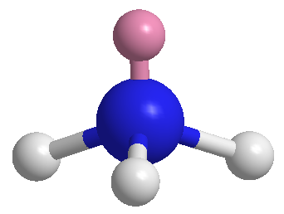
Given the following two thermochemical equations,
determine the enthalpy change associated with the synthesis of ammonia.
a) 283.0 kJ
d) –92.2 kJ
b) 92.2 kJ
e) –283.0 kJ
c) –3.2
Notes:
Answer: d

Slide 7
Given the following two thermochemical equations,
determine the enthalpy change associated with the synthesis of ammonia.
a) 283.0 kJ
d) –92.2 kJ
b) 92.2 kJ
e) –283.0 kJ
c) –3.2
Notes:
Answer: d

Slide 8
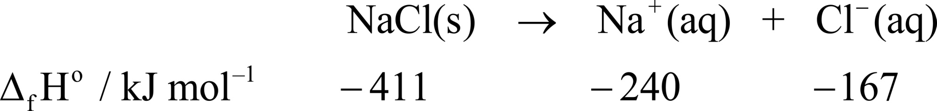
The heats of formation for each of the components involved in the dissolution of sodium chloride are given below.
What is the heat of dissolution of NaCl?
a) 4 kJ mol^{–1}
d) –668 kJ mol^{–1}
b) –4 kJ mol^{–1}
e) None of the above
c) 668 kJ mol^{–1}
Notes:
Answer: a

Slide 9
The heats of formation for each of the components involved in the dissolution of sodium chloride are given below.
What is the heat of dissolution of NaCl?
a) 4 kJ mol^{–1}
d) –668 kJ mol^{–1}
b) –4 kJ mol^{–1}
e) None of the above
c) 668 kJ mol^{–1}
Notes:
Answer: a

Slide 10
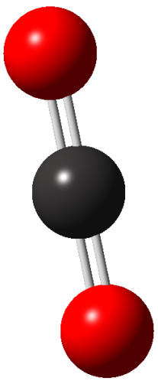
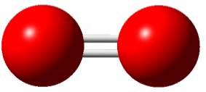
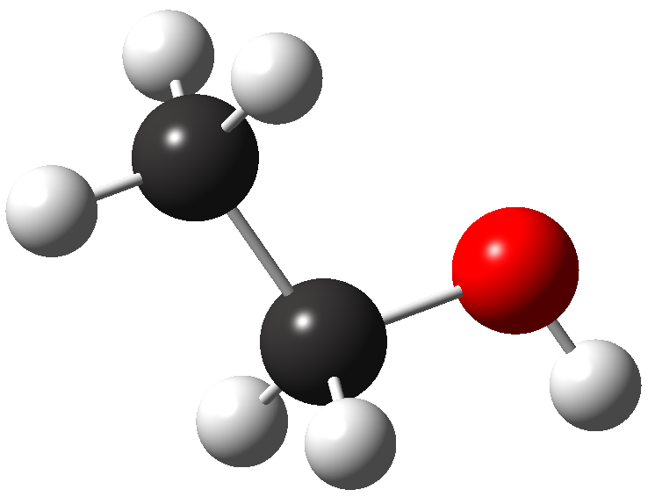
Given the bond dissociation energies shown, estimate the heat of formation of ethanol according to the reaction below.
498
a) 815 kJ mol^{–1}
804
b) 81 kJ mol^{–1}
c) –1264 kJ mol^{–1}
413
d) –2329 kJ mol^{–1}
360
348
463
e) 2329 kJ mol^{–1}
bond energies in kJ mol^{–1}
Notes:
Answer: c

Slide 11
Given the bond dissociation energies shown, estimate the heat of formation of ethanol according to the reaction below.
498
a) 815 kJ mol^{–1}
804
b) 81 kJ mol^{–1}
c) –1264 kJ mol^{–1}
413
d) –2329 kJ mol^{–1}
360
348
463
e) 2329 kJ mol^{–1}
bond energies in kJ mol^{–1}
Notes:
Answer: c

Slide 12
Which of the following statements is not true?
a) A negative enthalpy change favors spontaneity.
b) A positive entropy change favors spontaneity.
c) An endothermic reaction can be spontaneous if accompanied by a negative change in entropy.
d) An exothermic reaction will always be spontaneous.
e) If ΔG is negative for a process, the reaction is spontaneous.
Notes:
Answer: d

Slide 13
Which of the following statements is not true?
a) A negative enthalpy change favors spontaneity.
b) A positive entropy change favors spontaneity.
c) An endothermic reaction can be spontaneous if accompanied by a negative change in entropy.
d) An exothermic reaction will always be spontaneous.
e) If ΔG is negative for a process, the reaction is spontaneous.
Notes:
Answer: d

Slide 14
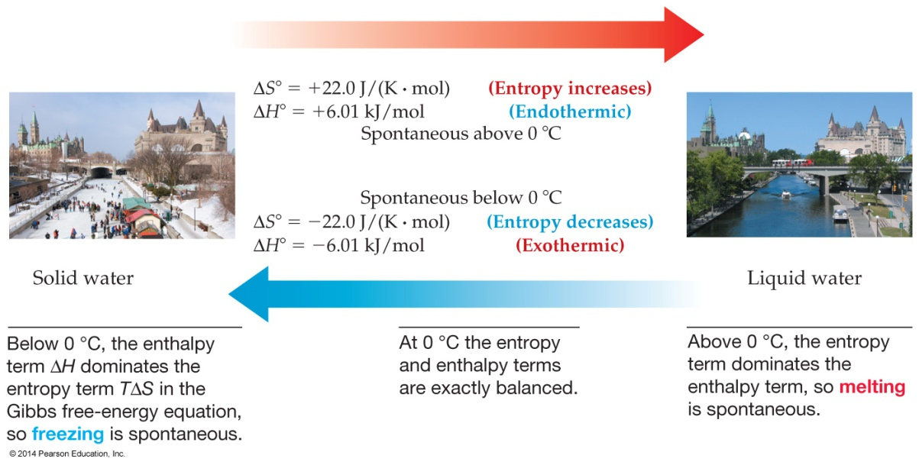
ice
water
Which of the following statements is correct?
a) Melting of ice is spontaneous since ΔS° is positive.
b) Water freezing is spontaneous since ΔH° is negative.
c) Water freezing is spontaneous only above 273 K.
d) Ice melting is spontaneous only above 273 K.
e) At 273 K (0 °C), melting of ice occurs spontaneously.
Notes:
Answer: d

Slide 15
ice
water
Which of the following statements is correct?
a) Melting of ice is spontaneous since ΔS° is positive.
b) Water freezing is spontaneous since ΔH° is negative.
c) Water freezing is spontaneous only above 273 K.
d) Ice melting is spontaneous only above 273 K.
e) At 273 K (0 °C), melting of ice occurs spontaneously.
Notes:
Answer: d

Slide 16


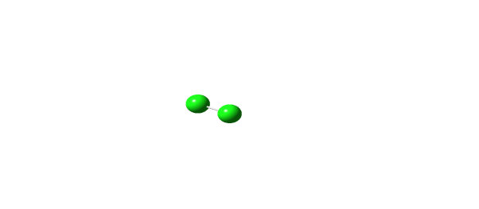
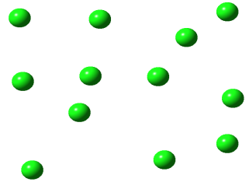
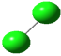

The bonds in diatomic chlorine will break to form chlorine atoms upon the absorption of light or heating. Which of the following statements is true about this reaction?
a) The reaction occurs with a decrease in entropy.
b) The reaction is exothermic.
c) The reaction is spontaneous at all temperatures.
d) The reaction is spontaneous at very low temperatures.
e) The reverse reaction is spontaneous at very low temperatures.
Notes:
Answer: e

Slide 17
The bonds in diatomic chlorine will break to form chlorine atoms upon the absorption of light or heating. Which of the following statements is true about this reaction?
a) The reaction occurs with a decrease in entropy.
b) The reaction is exothermic.
c) The reaction is spontaneous at all temperatures.
d) The reaction is spontaneous at very low temperatures.
e) The reverse reaction is spontaneous at very low temperatures.
Notes:
Answer: e

Slide 18
The reaction of nitrogen with hydrogen to make ammonia is as follows:
Determine ΔE in kJ if the reaction is carried out at a constant pressure of 40.0 atm and the change in volume is –1.12 L. (Hint: 1 J = 0.009869 L atm)
a) –4612 kJ
d) –87.7 kJ
b) –96.7 kJ
e) –4.52 kJ
c) –92.2 kJ
Notes:
Answer: d

Slide 19
The reaction of nitrogen with hydrogen to make ammonia is as follows:
Determine ΔE in kJ if the reaction is carried out at a constant pressure of 40.0 atm and the change in volume is –1.12 L. (Hint: 1 J = 0.009869 L atm)
a) –4612 kJ
d) –87.7 kJ
b) –96.7 kJ
e) –4.52 kJ
c) –92.2 kJ
Notes:
Answer: d

Slide 20
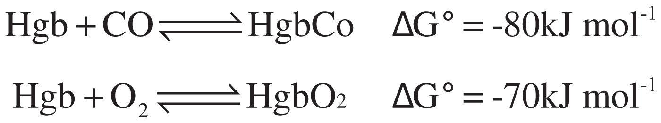
CO binds to iron in hemoglobin (Hgb) more favorably than does oxygen, which is why CO is poisonous.
What is the free energy change for O₂, replacing CO bound to an iron of hemoglobin?
a) 150 kJ mol^{–1}
d) –150 kJ mol^{–1}
b) 10 kJ mol^{–1}
e) 5600 kJ mol^{–1}
c) –10 kJ mol^{–1}
Notes:
Answer: b

Slide 21
CO binds to iron in hemoglobin (Hgb) more favorably than does oxygen, which is why CO is poisonous.
What is the free energy change for O₂, replacing CO bound to an iron of hemoglobin?
a) 150 kJ mol^{–1}
d) –150 kJ mol^{–1}
b) 10 kJ mol^{–1}
e) 5600 kJ mol^{–1}
c) –10 kJ mol^{–1}
Notes:
Answer: b

Slide 22
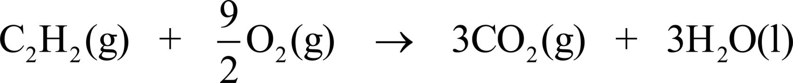
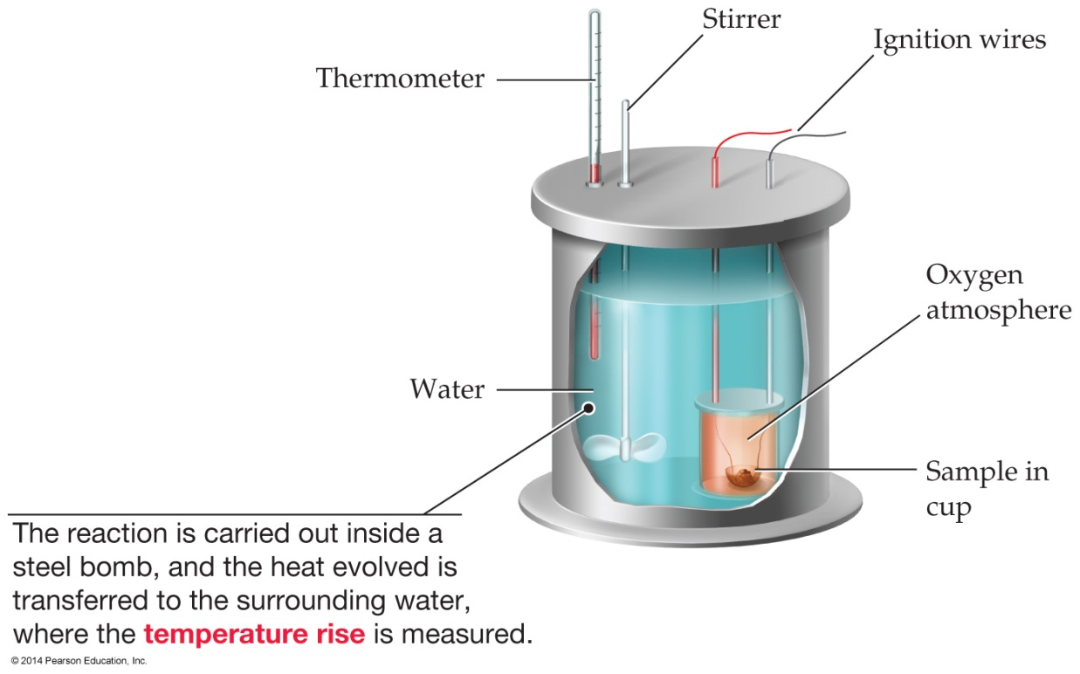
When 1 mol of cyclopropane (C₃H₆) is burned in a bomb calorimeter, 1960 kJ of heat is liberated from the system when the products return to 298 K.
What is the heat of combustion for this reaction?
(Hint: 1 mol gas produced yields PΔV = –2.5 kJ mol^{–1})
a) 1966 kJ
d) 1954 kJ
b) –1966 kJ
e) –1954 kJ
c) –1960 kJ
f) 1960 kJ
Notes:
Answer: b

Slide 23
When 1 mol of cyclopropane (C₃H₆) is burned in a bomb calorimeter, 1960 kJ of heat is liberated from the system when the products return to 298 K.
What is the heat of combustion for this reaction?
(Hint: 1 mol gas produced yields PΔV = –2.5 kJ mol^{–1})
a) 1966 kJ
d) 1954 kJ
b) –1966 kJ
e) –1954 kJ
c) –1960 kJ
f) 1960 kJ
Notes:
Answer: b

Slide 24
You plan to take a bath but your water heater broke. In the tub you have 30 kg of water at 20 °C. You decide to use boiling water from a kettle to heat up the tub. Assuming no heat is lost to the surroundings, how much boiling water do you need to bring the water temperature up to 40 °C? (Hint: Recall that heat lost to surroundings = heat gained to system.)
a) 1 kg
b) 5 kg
c) 10 kg
d) 20 kg
e) 40 kg
Notes:
Answer: c

Slide 25
You plan to take a bath but your water heater broke. In the tub you have 30 kg of water at 20 °C. You decide to use boiling water from a kettle to heat up the tub. Assuming no heat is lost to the surroundings, how much boiling water do you need to bring the water temperature up to 40 °C? (Hint: Recall that heat lost to surroundings = heat gained to system.)
a) 1 kg
b) 5 kg
c) 10 kg
d) 20 kg
e) 40 kg
Notes:
Answer: c

Slide 26
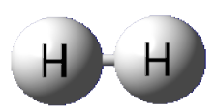
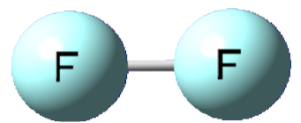
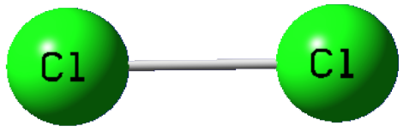
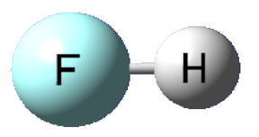
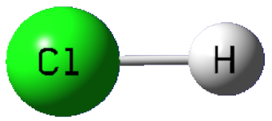
Which reaction is most exothermic and by how much?
440
a)
159
b)
c)
243
d)
565
e) none of the above
431
(all in kJ mol^{–1})
Notes:
Answer: b

Slide 27
Which reaction is most exothermic and by how much?
440
a)
159
b)
c)
243
d)
565
e) none of the above
431
(all in kJ mol^{–1})
Notes:
Answer: b

Slide 28
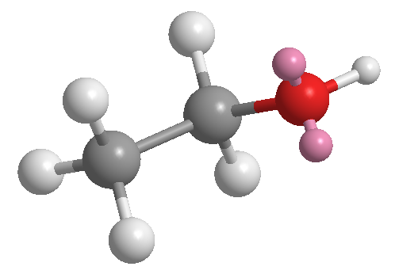
Which of the following is the chemical reaction corresponding to the heat of formation of liquid ethanol?
a)
b)
c)
d)
e)
Notes:
Answer: d

Slide 29
Which of the following is the chemical reaction corresponding to the heat of formation of liquid ethanol?
a)
b)
c)
d)
e)
Notes:
Answer: d

Slide 30
At 25 °C the heat of fusion of aluminum is 10.6 kJ/mol and the heat of sublimation is 326.4 kJ/mol. What is the heat of vaporization of aluminum at 25 °C?
a) 158.2 kJ/mol
b) 168.5 kJ/mol
c) 315.8 kJ/mol
d) 337.0 kJ/mol
e) None of the above
Notes:
Answer: c

Slide 31
At 25 °C the heat of fusion of aluminum is 10.6 kJ/mol and the heat of sublimation is 326.4 kJ/mol. What is the heat of vaporization of aluminum at 25 °C?
a) 158.2 kJ/mol
b) 168.5 kJ/mol
c) 315.8 kJ/mol
d) 337.0 kJ/mol
e) None of the above
Notes:
Answer: c

Slide 32
How much heat is absorbed when 30.00 g of C(s) reacts in the presence of excess SO₂(g) to produce CS₂(l) and CO(g) according to the following chemical equation?
5 C(graph) + 2 SO₂(g) → CS₂(l) + 4 CO(g) ΔH° = +239.9 kJ
a) 119.9 kJ
b) 239.9 kJ
c) 599.2 kJ
d) 1439 kJ
e) None of the above
Notes:
Answer: a

Slide 33
How much heat is absorbed when 30.00 g of C(s) reacts in the presence of excess SO₂(g) to produce CS₂(l) and CO(g) according to the following chemical equation?
5 C(graph) + 2 SO₂(g) → CS₂(l) + 4 CO(g) ΔH° = +239.9 kJ
a) 119.9 kJ
b) 239.9 kJ
c) 599.2 kJ
d) 1439 kJ
e) None of the above
Notes:
Answer: a

Slide 34
Find ΔH for C₃H₈ (g) + 6 H₂O (g) → 3 CO₂ (g) + 10 H₂, given:
C₃H₈ (g) + 3 H₂O (g) → 3 CO (g) + 7 H₂ (g), ΔH = 499 kJ;
CO (g) + H₂O (g) → CO₂ (g) + H₂ (g), ΔH = –41 kJ
a) 376 kJ
b) 458 kJ
c) 540 kJ
d) 622 kJ
e) None of the above
Notes:
Answer: a

Slide 35
Find ΔH for C₃H₈ (g) + 6 H₂O (g) → 3 CO₂ (g) + 10 H₂, given:
C₃H₈ (g) + 3 H₂O (g) → 3 CO (g) + 7 H₂ (g), ΔH = 499 kJ;
CO (g) + H₂O (g) → CO₂ (g) + H₂ (g), ΔH = –41 kJ
a) 376 kJ
b) 458 kJ
c) 540 kJ
d) 622 kJ
e) None of the above
Notes:
Answer: a

Slide 36
Use the given average bond dissociation energies, D, to estimate ΔH for the reaction of methane, CH₄(g), with fluorine according to the equation
CH₄(g) + 2 F₂(g) → CF₄(g) + 2 H₂(g).
Bond D (kJ/mol)
C–F 450
C–H 410
F–F 159
H–H 436
a) –714 kJ
b) –316 kJ
c) +316 kJ
d) +714 kJ
e) None of the above
Notes:
Answer: a

Slide 37
Use the given average bond dissociation energies, D, to estimate ΔH for the reaction of methane, CH₄(g), with fluorine according to the equation
CH₄(g) + 2 F₂(g) → CF₄(g) + 2 H₂(g).
Bond D (kJ/mol)
C–F 450
C–H 410
F–F 159
H–H 436
a) –714 kJ
b) –316 kJ
c) +316 kJ
d) +714 kJ
e) None of the above
Notes:
Answer: a

Slide 38
At a given temperature and pressure, which of the following would be expected to have the greatest molar entropy?
a) F₂(s)
b) F₂(l)
c) F₂(g)
d) CaF₂(s)
e) All of the above would have about the same molar entropy.
Notes:
Answer: c

Slide 39
At a given temperature and pressure, which of the following would be expected to have the greatest molar entropy?
a) F₂(s)
b) F₂(l)
c) F₂(g)
d) CaF₂(s)
e) All of the above would have about the same molar entropy.
Notes:
Answer: c

Slide 40
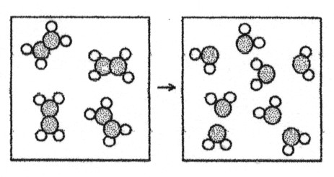
What are the signs of ΔH and ΔS for the reaction represented in the above drawing?
a) ΔH = +, ΔS = +
b) ΔH = +, ΔS = –
c) ΔH = –, ΔS = +
d) ΔH = –, ΔS = –
e) Impossible to determine
Notes:
Answer: a

Slide 41
What are the signs of ΔH and ΔS for the reaction represented in the above drawing?
a) ΔH = +, ΔS = +
b) ΔH = +, ΔS = –
c) ΔH = –, ΔS = +
d) ΔH = –, ΔS = –
e) Impossible to determine
Notes:
Answer: a

Slide 42
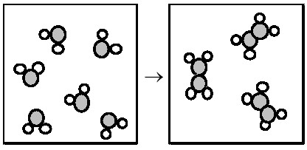
What are the signs of ΔH and ΔS for the reaction represented in the above drawing?
a) ΔH = +, ΔS = +
b) ΔH = +, ΔS = –
c) ΔH = –, ΔS = +
d) ΔH = –, ΔS = –
e) Impossible to determine
Notes:
Answer: d

Slide 43
What are the signs of ΔH and ΔS for the reaction represented in the above drawing?
a) ΔH = +, ΔS = +
b) ΔH = +, ΔS = –
c) ΔH = –, ΔS = +
d) ΔH = –, ΔS = –
e) Impossible to determine
Notes:
Answer: d

Slide 44
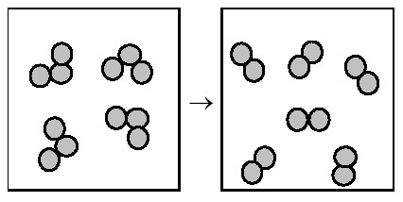
What are the signs of ΔH and ΔS for the reaction represented in the above drawing, which represents O₃ forming O₂?
a) ΔH = +, ΔS = +
b) ΔH = +, ΔS = –
c) ΔH = –, ΔS = +
d) ΔH = –, ΔS = –
e) Impossible to determine
Notes:
Answer: c

Slide 45
What are the signs of ΔH and ΔS for the reaction represented in the above drawing, which represents O₃ forming O₂?
a) ΔH = +, ΔS = +
b) ΔH = +, ΔS = –
c) ΔH = –, ΔS = +
d) ΔH = –, ΔS = –
e) Impossible to determine
Notes:
Answer: c

